Slide 1
To Do List

Slide 2

Team Members
30. Ashish Yadav
05. Atreya Ganguly
13. Harshit Mishra
14. Mitesh Munankar
Technologies Used
MySQL, PHP, JavaScript
Project Guide
Prof. Dhananjay Raut
Project Genre
Web Based Project

Slide 3


Slide 4
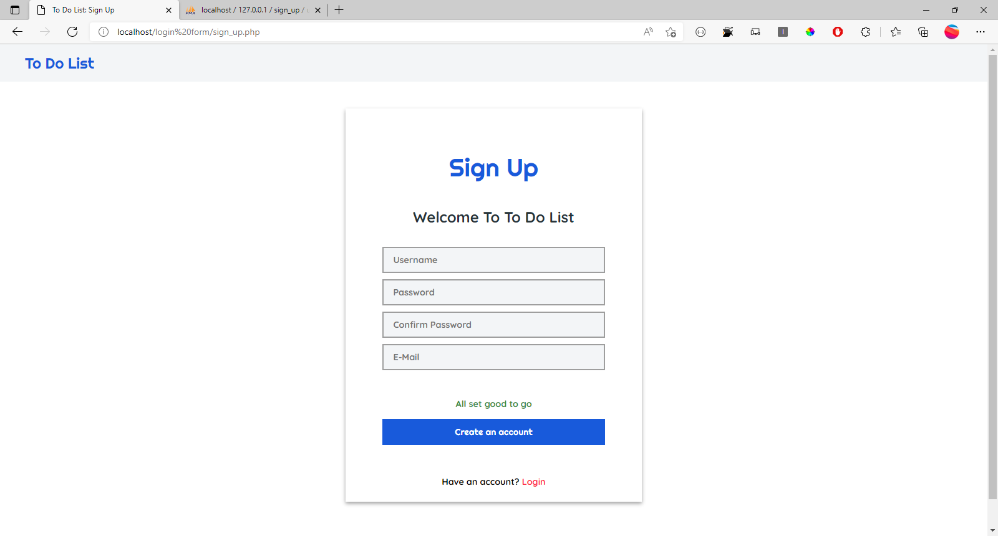

Slide 5
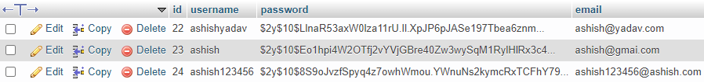
Database for User Login and sign up form
Username
Hashed password
User email

Slide 6
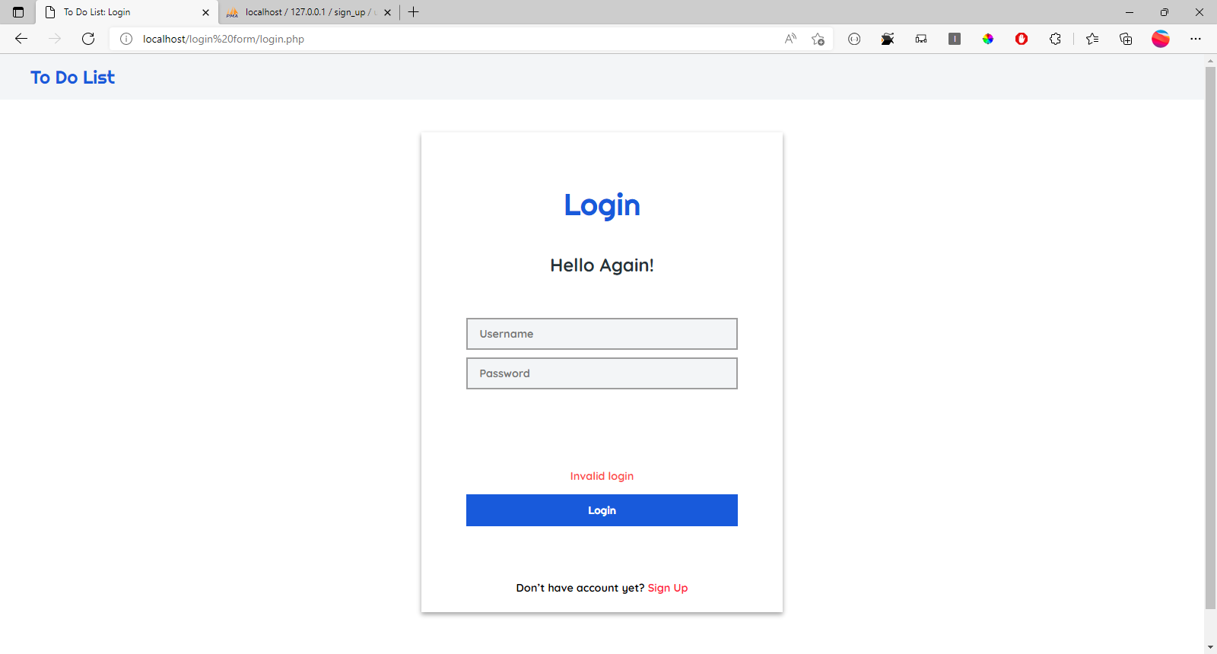

Slide 7


Add New Task
+
Some Task
Pending
Completed
All
The quick brown fox jumps over the lazy dog. The quick brown fox jumps over the lazy dog. The quick brown fox jumps over the lazy dog. The quick brown fox jumps over the lazy dog. The quick brown fox jumps over the lazy dog.
The quick brown fox jumps over the lazy dog. The quick brown fox jumps over the lazy dog. The quick brown fox jumps over the lazy dog. The quick brown fox jumps over the lazy dog. The quick brown fox jumps over the lazy dog.
15/03/2022, 05:45 PM

Slide 8





Add New Task
+
Some Task
Pending
Completed
All
The quick brown fox jumps over the lazy dog. The quick brown fox jumps over the lazy dog. The quick brown fox jumps over the lazy dog. The quick brown fox jumps over the lazy dog. The quick brown fox jumps over the lazy dog.
The quick brown fox jumps over the lazy dog. The quick brown fox jumps over the lazy dog. The quick brown fox jumps over the lazy dog. The quick brown fox jumps over the lazy dog. The quick brown fox jumps over the lazy dog.
Edit
Delete
Done
Reminder
15/03/2022, 05:45 PM

Slide 9
Add New Task
+
Some Task
Pending
Completed
All
The quick brown fox jumps over the lazy dog. The quick brown fox jumps over the lazy dog. The quick brown fox jumps over the lazy dog. The quick brown fox jumps over the lazy dog. The quick brown fox jumps over the lazy dog.
The quick brown fox jumps over the lazy dog. The quick brown fox jumps over the lazy dog. The quick brown fox jumps over the lazy dog. The quick brown fox jumps over the lazy dog. The quick brown fox jumps over the lazy dog.
15/03/2022, 05:45 PM

Slide 10
Add New Task
+
Some Task
Pending
Completed
All
The quick brown fox jumps over the lazy dog. The quick brown fox jumps over the lazy dog. The quick brown fox jumps over the lazy dog. The quick brown fox jumps over the lazy dog. The quick brown fox jumps over the lazy dog.
The quick brown fox jumps over the lazy dog. The quick brown fox jumps over the lazy dog. The quick brown fox jumps over the lazy dog. The quick brown fox jumps over the lazy dog. The quick brown fox jumps over the lazy dog.
Edit
Delete
Done
Reminder
15/03/2022, 05:45 PM

Slide 11

Add New Task
+
Some Task
Remainder
Pending
Completed
All
Date
30
03
2022
The quick brown fox jumps over the lazy dog. The quick brown fox jumps over the lazy dog. The quick brown fox jumps over the lazy dog. The quick brown fox jumps over the lazy dog. The quick brown fox jumps over the lazy dog.
The quick brown fox jumps over the lazy dog. The quick brown fox jumps over the lazy dog. The quick brown fox jumps over the lazy dog. The quick brown fox jumps over the lazy dog. The quick brown fox jumps over the lazy dog.
Edit
Time
Delete
09
45
AM
Done
Reminder
Remind Me
15/03/2022, 05:45 PM
Remainder will be sent on your e mail

